Slide 1
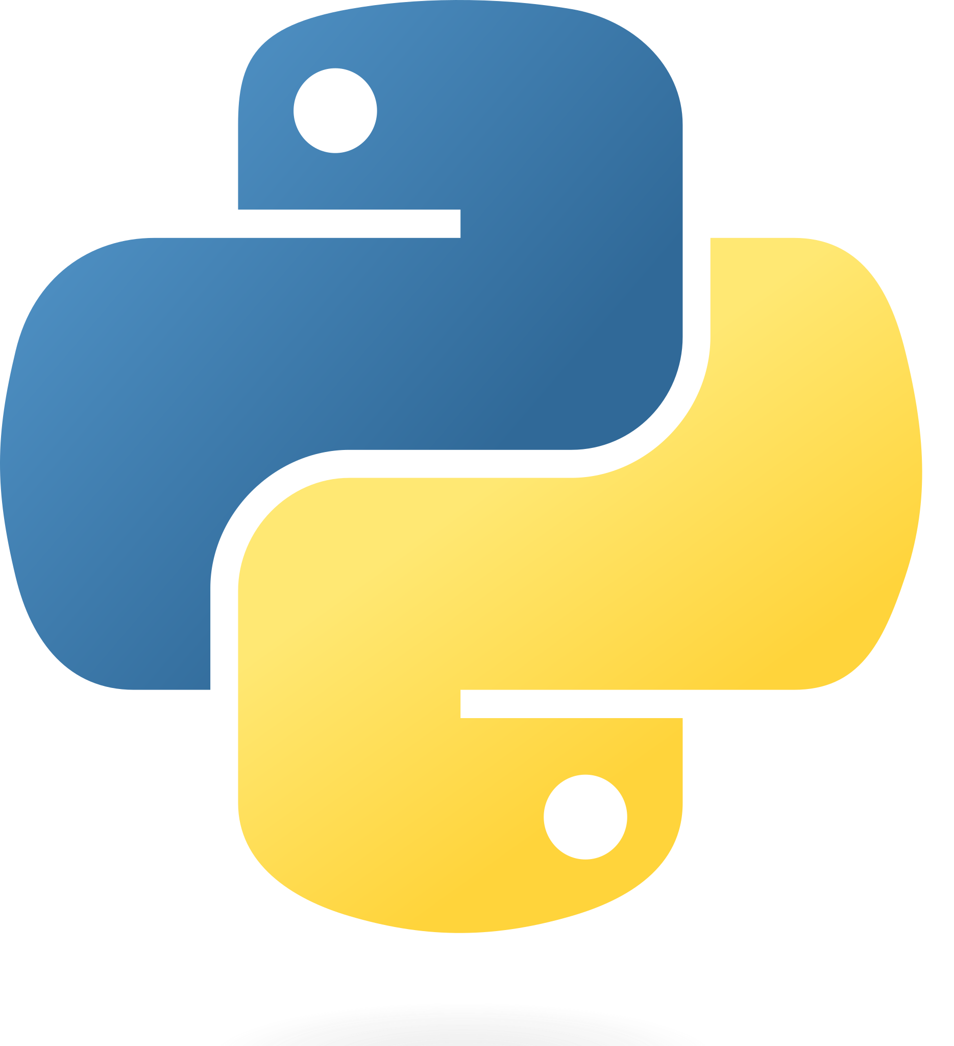
Introduction To Python Workshop

Slide 2
Grras Solutions
GRRAS Solutions Pvt. Ltd. has been an authorized and renowned partner of Red Hat, Amazon, Microsoft & CISCO since 2008.
We have our own Pearson VUE examination center, Redhat Authorised Centre & Kryterion Authorised Testing Center.
We have a broad spectrum of courses like Python Programming, Data Analytics, RedHat Linux, DevOps & cloud computing, MERN stack, Azure, Full Stack Web Development, Angular, Data Science, Machine Learning, Artificial Intelligence, AWS, Ux-Ui Design with Fundamental of Graphic Designing, Digital Marketing and Salesforce.

Slide 3
Agenda
What is Python
History Of Python
Why Python
Features Of Python
Top companies Uses Python
Application In Python
IDES
Libraries

Slide 4
Introduction To Python
High-level
Dynamic
Interpreted
.It supports object-oriented programming as well
Procedural –oriented Programming

Slide 5
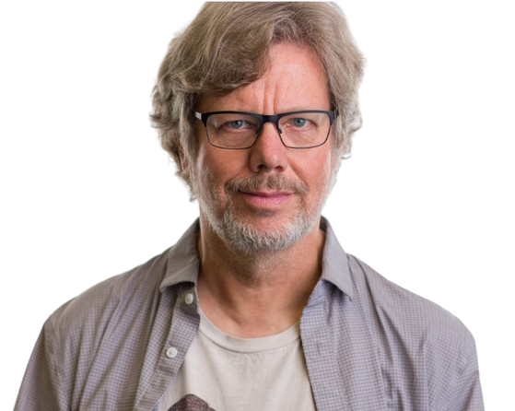
History Of Python
The implementation of Python was started in December 1989 by Guido Van Rossum at CWI in Netherland.

Slide 6
Why the Name Python?
Guido van Rossum was reading the script of a popular BBC comedy series "Monty Python's Flying Circus".
Van Rossum wanted to select a name which unique, sort, and little-bit mysterious. So he decided to select naming Python after the "Monty Python's Flying Circus" for their newly created programming language.

Slide 7
Version Of Python
Created by
Guido Van Rossum
Python 0.9.0
Python 2.0
1980
1991
2000
Python 3.0
End of the python 2 series
Latest Version 3.13.5
2008
2020
2025

Slide 8
Why Python?
Easy to code
Easy to Read
High Level language
Object-Oriented Language
GUI Programming Support
Large Community Support
Easy to Debug
Allocating Memory Dynamically

Slide 9
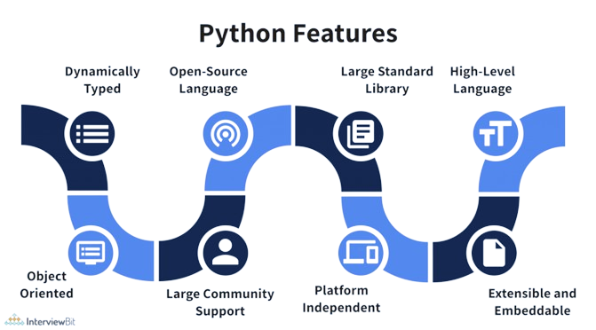

Slide 10
Strongly Typed and Dynamic Typed
Strongly Typed
Dynamic Typed
This means that operations between incompatible data types will raise errors
x = "Hello“
y = 10
z = x + y
# This will raise a Type Error
This means that you don't need to declare the data type of a variable explicitly when you define it.
x = 10 # x is an integer
y = "Hello" # y is a string
z = 3.14 # z is a float

Slide 11
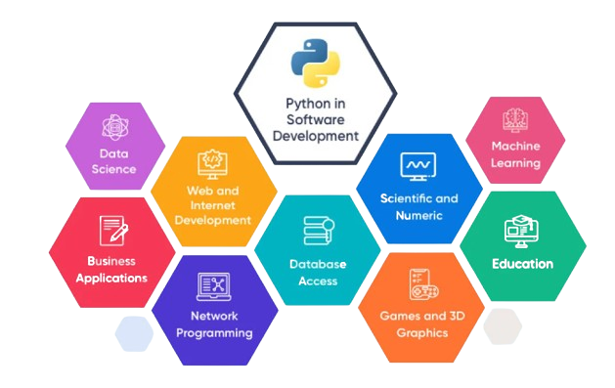
Application Of Python

Slide 12
Top Fields Using Python Today
Artificial Intelligence & Machine Learning
Data Science & Analytics
Web Development
Scientific Computing & Research
Automation & Scripting
Game Development
Application Development
Finance & FinTech
Bioinformatics & Healthcare
Cybersecurity

Slide 13
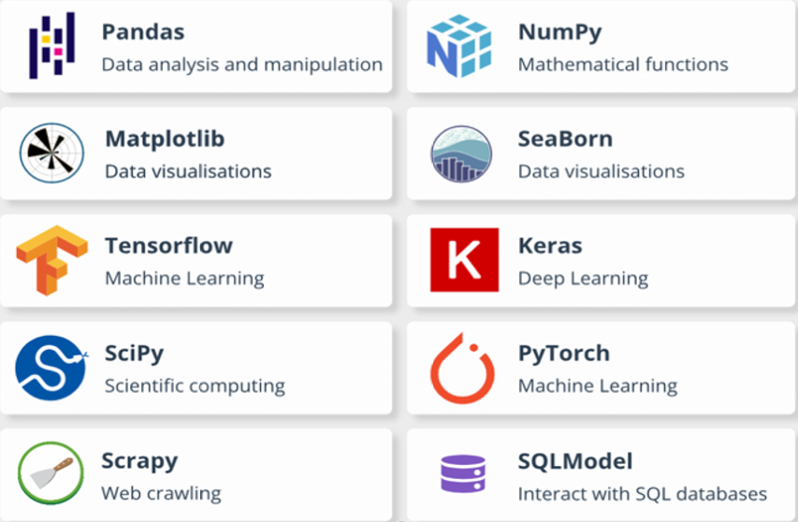
Top Libraries

Slide 14
Different Libraries Use in different Domain
Web Development :-Django, Flask
Ml And AI :- NumPy , Keras , Scipy, Seaborn
Data Science :- TensorFlow ,Pandas
Game Development :-Pygame
Audio and Visual Application :- Pyo, Scipy
Desktop GUI :-Pyqt, Kivy
Web Scraping :- Pandas, matplotlib, Selenium

Slide 15
Key benefit of using Python For Web Development
Object Oriented
Integration with IOT
Free and Open Source
Fast Development
Fewer Line Of Code
Extensive
Libraries
Libraries

Slide 16
Python FrameWorks
Flask
cherryPy
Tornado
Django

Slide 17
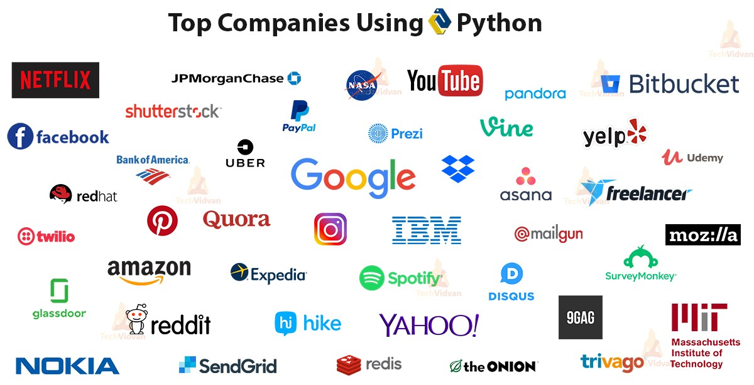

Slide 18
IDE
IDE :-Integrated Development Environment
An IDE typically includes a source code editor, build automation tools, and a debugger, along with other features tailored to the specific needs of software development.

Slide 19
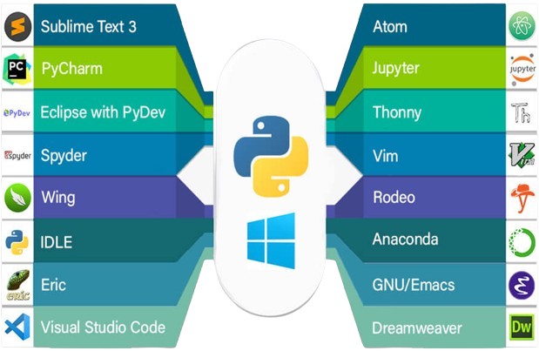
Ide of python

Slide 20
Comparison
Topic | C++ | Java | Python
Developed year | 1979 | 1991 | 1991
Developed By | Bjarne Strustrup | James Godling | Guido van Rossum
Paradigm | Object Oriented | Object oriented | Mutli-Paradigm
Platform Dependency | Dependent | Independent | Independent
Inheritance | Supported | Supported | Supported
Syntax | Complex syntax | C-like syntax | Easy to read and write
Memory Allocation | Manual allocation Manual deallocation | Manual allocation Automatic garbage allocation | Automatic allocation Automatic deallocation

Slide 21

Any Queries

Slide 22


